Slide 1
scRNA-seq sample preparation using CT26 syngeneic model
Yaya Wang
2/26/2021

Slide 2
Study design
Untreated
24 h
Mice implanted with CT26-HER2 tumors
Harvest tumor
Dissociation of tumor
Treated with HER2-STING ADC
CD45 enrichment
3 days
FACS analysis
Thaw tumor cells
Freeze tumor cells

Slide 3
HER2-STING ADC induces significant tumor cell loss in CT-26/HER2 model
*
*

Slide 4
Thawed CD45+ TILs maintain good viability (>80%) with modest reduction in cell number
1.3 M
0.7 M
CD45+ purity (80.0% for untreated and 92.3% for treated sample)
Cell concentration needs to be 700-1,200 cells/μl prior to run 10x Genomics Single Cell protocols, only need to load 5k to 10k cells

Slide 5
Freeze/thaw process has minimum impact on TIL composition
CD11b+, Ly6G+, Ly6Clow
CD11b+, Ly6G-, Ly6Chigh
CD11b+, F4/80+, Ly6C-, Ly6G-
CD3+, CD8-, CD4+
CD3+, CD8+, CD4-
CD3-, NKp46+

Slide 6
HER2-STING ADC activates immune cells in CT26 tumors
Macrophage
CD8 T cell

Slide 7
Conclusion
For untreated condition, 1 or 2 tumors (~ 100 mm³) would be sufficient for scRNA-seq study.
For treated condition, 3 or less tumors (~ 100 mm³) would be sufficient for scRNA-seq study.
Thawed CD45+ TILs have good viability (>80%), which meets the standards of 10x Genomics Single Cell protocol.
Freeze/thaw process has minimum impact on immune cell composition in the tumor.

Slide 8
Discussion
Treatment time
Shall we include additional time points?
Number of mice
Shall we pool animals for untreated condition (biological replicates)?

Slide 9
Backup slides

Slide 10
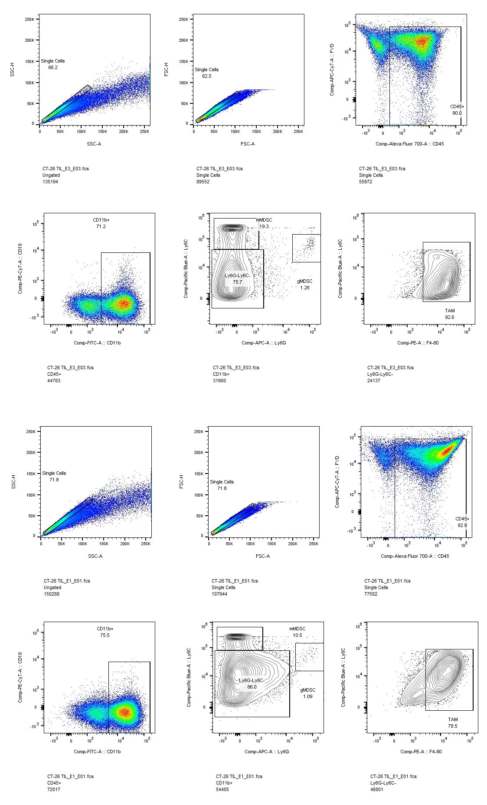
Gating strategy for myeloid panel

